Slide 1
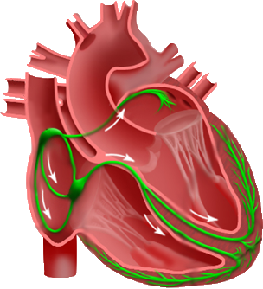
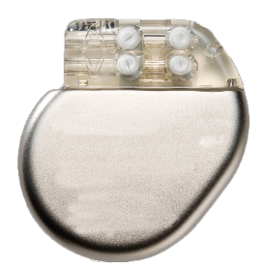
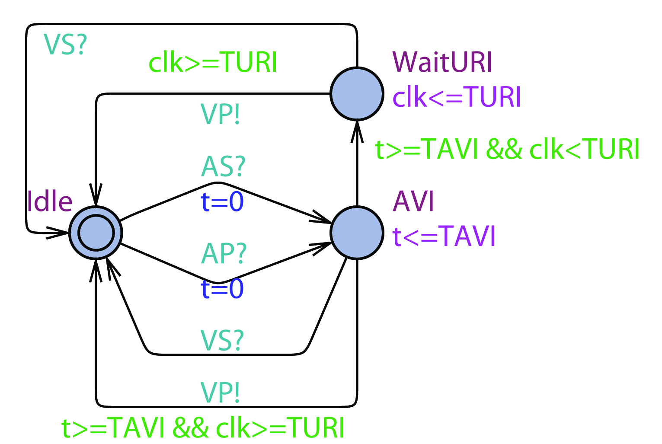
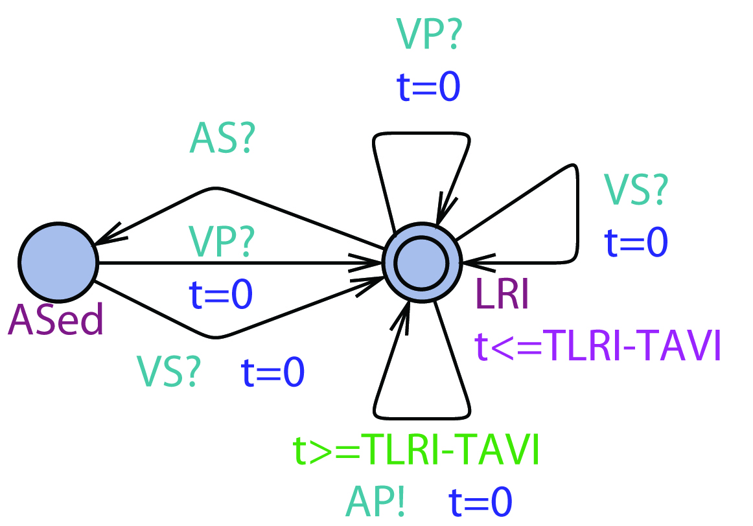
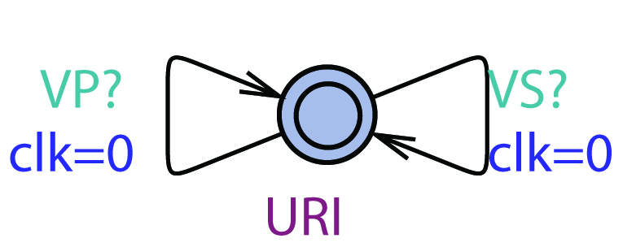
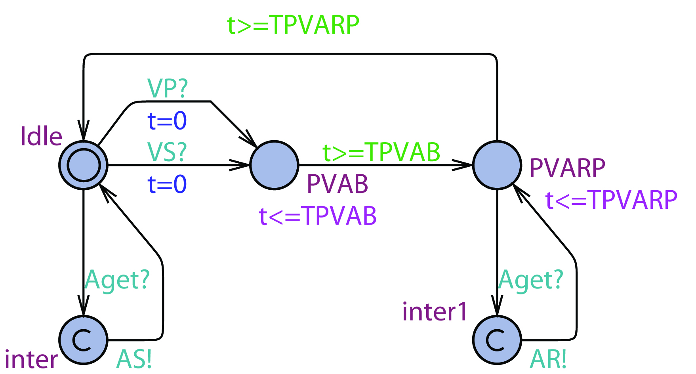
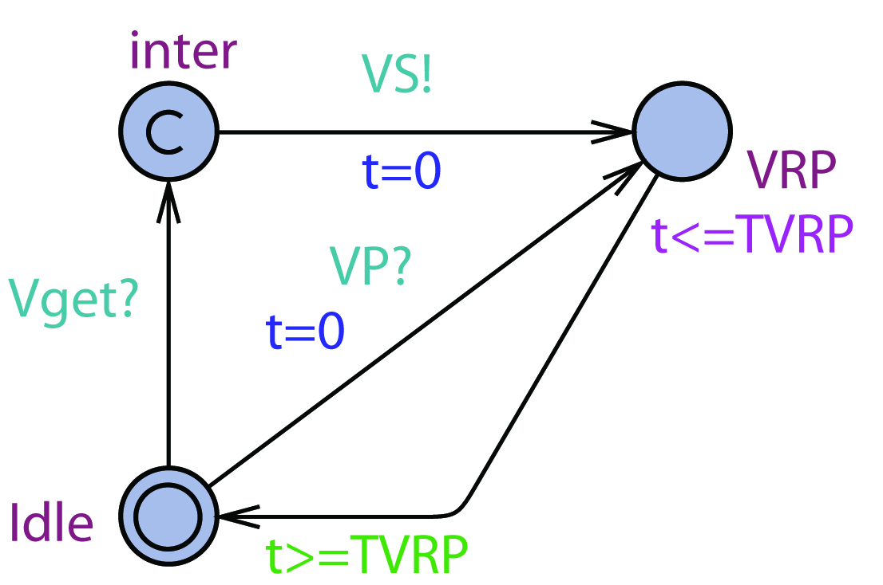
AS?
AS?
VS?
LRI
AP!
VS?
AVI
VP!
VS?
VP?
URI
VP?
VP?
Heart
Pacemaker
Non-deterministic
UPPAAL Model
Verification
Interpolation
UPP2SF
Model Translation
(a) LRI component
(b) AVI component
(c) URI component
Deterministic
Stateflow
Chart
Aget?
PVARP
AS!
Vget?
Simulation
VS?
VRP
VS!
VP?
AR!
VP?
HDL Coder
Simulink Coder
FPGA
implementation
C Code
implementation
Implementation
(d) PVARP component
(e) VRP component
Notes:
On the pacemaker side, we developed a model based design tool chain for pacemaker. The closed-loop system including the pacemaker and the heart are first modeled in model checker UPPAAL and some safety properties are checked.
Using the tool UPP2SF, which is a matlab script developed by us, the UPPAAL model of the pacemaker can be rigorously translated into stateflow chart
Using the realtime workshop in simulink, the stateflow chart can be translated into C code and implemented on any embedded platform.
Using this automated tool chain, we can rule out discrepancies introduced by manual translations between layers. Together with our heart model implementation, we can ensure all properties satisfied at verification level still holds after implementation.

